Slide 1
Anatomy of the Midbrain
Presented by Omosola Tobi

Slide 2
OUTLINE
Introduction to midbrain
Parts/features of the midbrain
Ascending and descending pathways
Blood supply
Functions of the midbrain
Clinical correlates

Slide 3
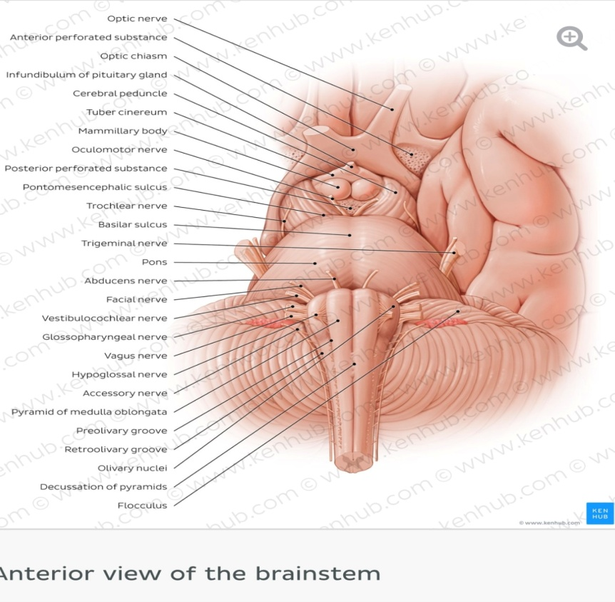
The midbrain
The midbrain or mesencephalon is
the most rostral part of the
brainstem that connects the pons
and cerebellum with the forebrain. It
is the shortest part of the brainstem.
It is situated between the
diencephalon and pons and is
traversed by the cerebral aqueduct.
It contains the relay nuclei involved
in processing of auditory and visual
information.

Slide 4

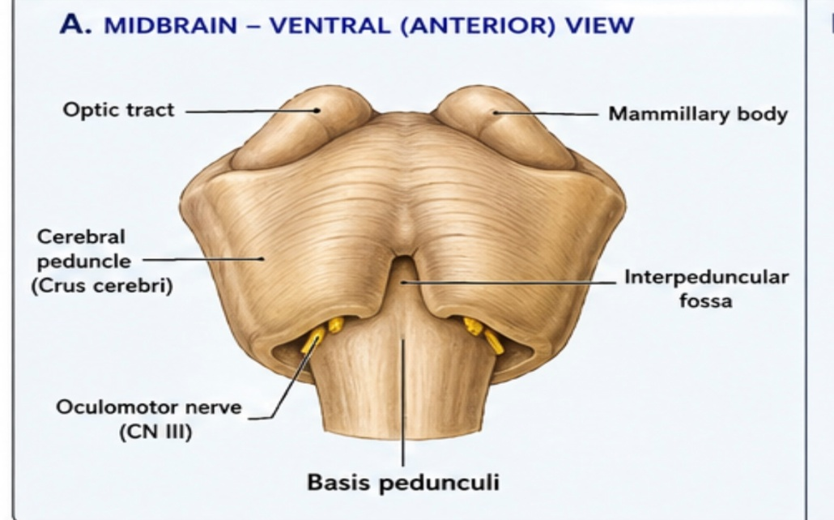
Features of the midbrain
External structure:
Anterior (ventral) surface: is marked by the two stalks called Cerebral peduncles.
The peduncles are composed of many pathways (descending motor tract) that travels between the cerebral cortex and spinal cord.
As the peduncles converge caudally towards the pons, they bound a fossa on the anterior surface of the midbrain called Interpeduncular fossa.
The floor of this fossa is formed by the posterior perforated substance, which is a layer of gray matter pierced by branches of the posterior cerebral artery that supply the midbrain.

Slide 5
Contents of interpeduncular fossa
The terminal bifurcation of the basilar artery into the posterior cerebral arteries.
The posterior communicating arteries
The emerging roots of the oculomotor nerve (CN 111)

Slide 6
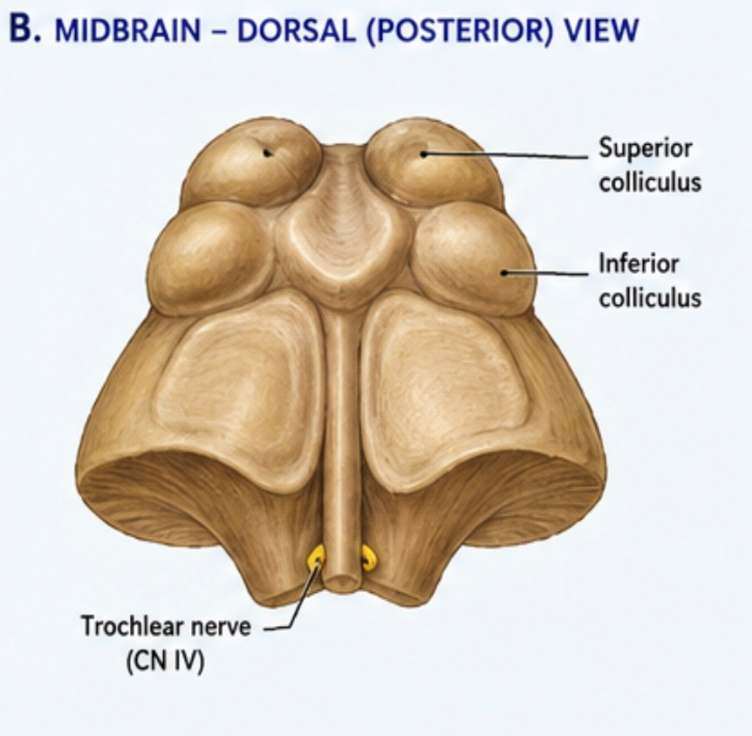
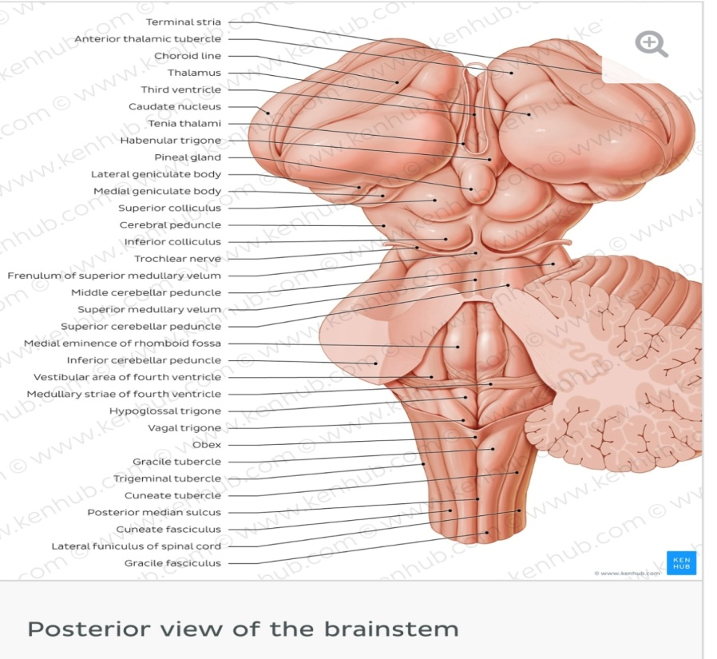
B. Posterior (dorsal) surface:
The posterior surface of the midbrain is called Tectum (roof). The tectum has 4 tubercles on its surface which lie inferior to the pineal gland.
The upper pair of the tubercles are the left and right superior colliculi
The lower pair are the left and right inferior
colliculi
Due to this arrangement, the tectum is also called the Quadrigeminal plate while the colliculi are collectively known as corpora quadrigemina.
The colliculi are separated from each other by the cruciform sulcus.
Rostrally, the sulcus extend from the depression of the pineal gland. Its caudal end is continued by frenulum of the superior medullary velum.
The frenulum separates the inferior colliculi from eachother and the Trochlear nerve (CN IV) emerges from either side of the frenulum.

Slide 7

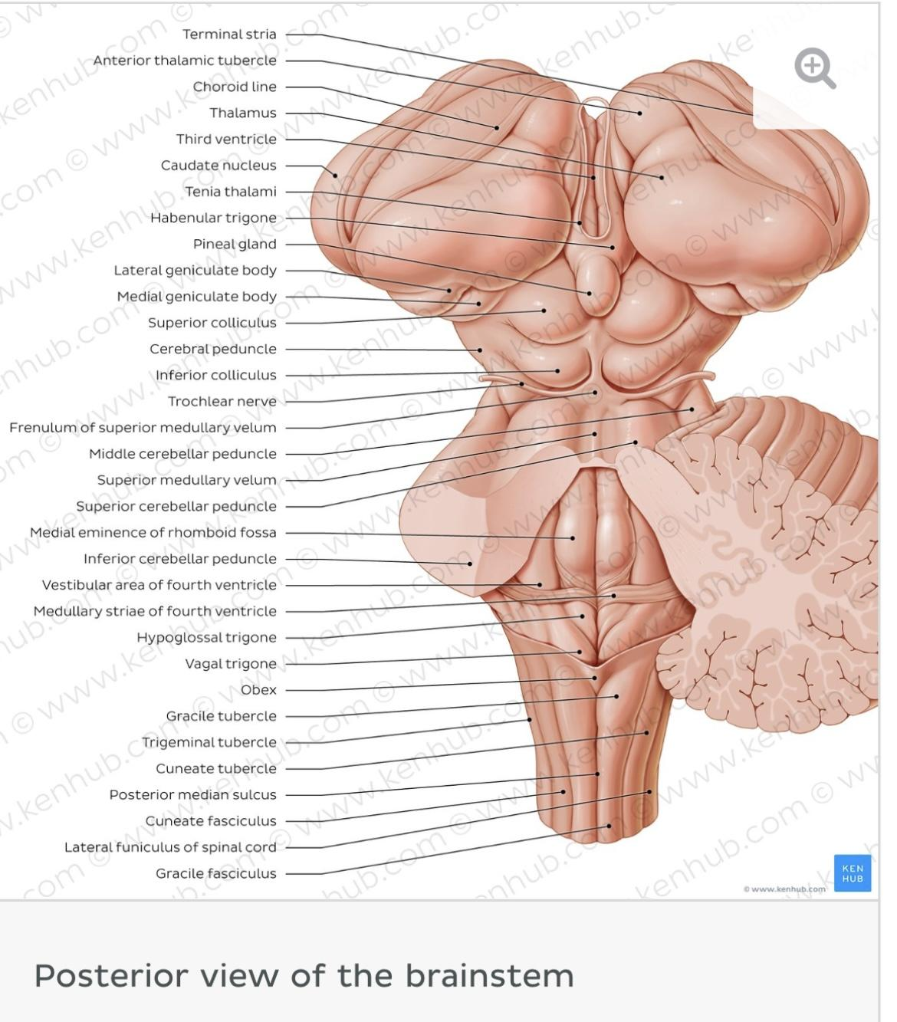

Slide 8
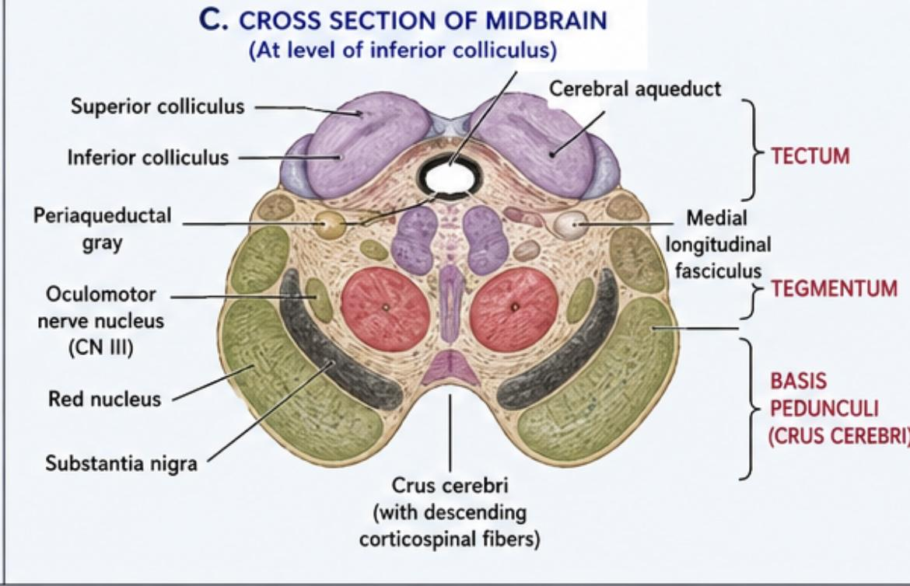
2. Inferior surface of midbrain
It consists of two major parts: cerebral peduncles and tectum.
The cerebral peduncles consists of the crura cerebri and tegmentum. They are separated from each other by a darkened stripe called the substantia nigra.
The dorsal part of the tegmentum is traversed by the cerebral aqueduct, which connects the third and fourth ventricles of the brain.
The tectum lies dorsal to the tegmentum and cerebral aqueduct and it contains the nuclei of the superior and inferior colliculi.
The ventral region on cross-section is called crus cerebri which contains white matter from the cortex.

Slide 9
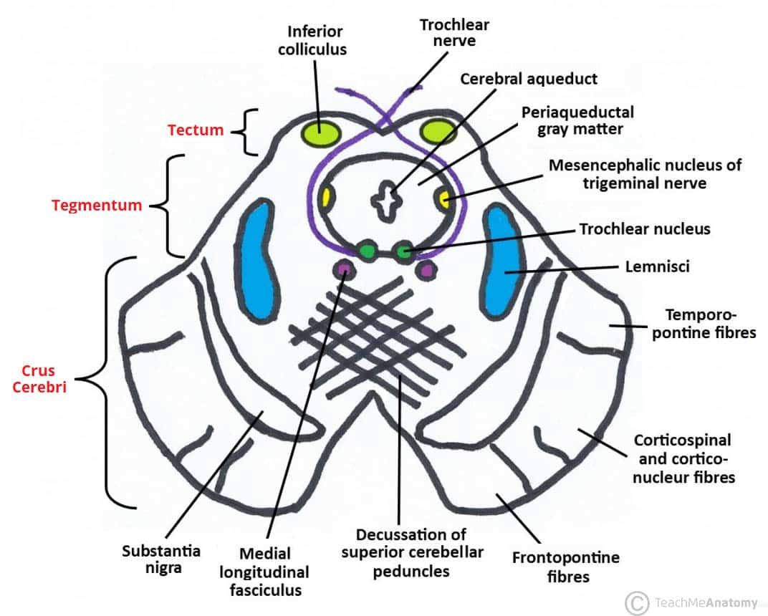
Crus cerebri
The crus cerebri is the most ventral area of each cerebral peduncle. It is composed of 3 descending pathways which have specific arrangements.
These pathways are collectively called the longitudinal pontine fibers:
Corticospinal and corticonuclear pathways: travels the spinal cord and cranial nerve nuclei respectively. Together, these pathways occupy the central two-thirds of each crus cerebri.
Corticopontine pathways: divide into the frontopontine and temporopontine tracts based on which part of the cerebral cortex they originate.
The frontopontine tract occupies the medial sixth of ipsilateral crus, while the temporopontine tract composes the lateral sixth of ipsilateral crus.

Slide 10
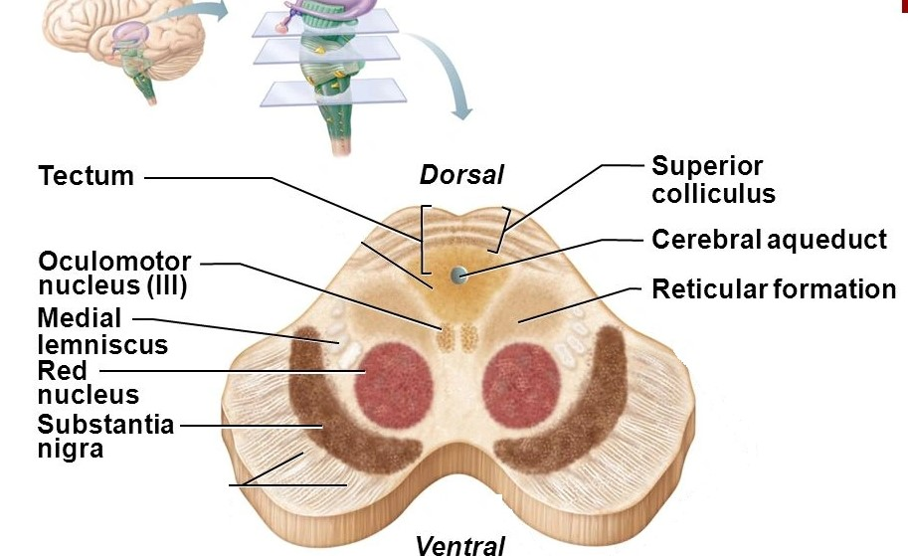
Tegmentum (pretectal area)
The mesencephalic tegmentum,
also known as the Pretectum is the
central part of the midbrain.
It contains the reticular and cranial
nerve nuclei as well as several
neural pathways.
Reticular formation: a network of
phylogenetically old nuclei that
regulates basic and vital autonomic
functions.
The mesencephalic part of the
reticular formation lies within two
clusters that are found anterolateral
to the periaqueductal gray.

Slide 11
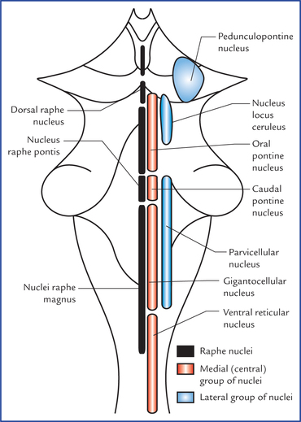
Tegmentum (cont’d)
Each cluster is divided into 3 columns:
Gigantocellar reticular nuclei (medial column): for motor coordination
Raphe nuclei (median column): for pain and mood regulation
Parvocellar reticular nuclei (lateral column): regulation of breathing

Slide 12
Periaqueductal gray (pag)
This is a mass of neuronal bodies that
encircles the cerebral aqueduct. Its
function is to modulate pain by
releasing endogenous opoids such as
enkephalin, serotonin and dynorphin.
The PAG connects to the
somatosensory areas of the
cerebral cortex, as well as with the
lower spinal cord centers.
Cranial nerve nuclei: The nuclei of the
oculomotor (CN III), trochlear nerve
(CN IV) and trigeminal nerves (CN V)
are located near the PAG matter.

Slide 13
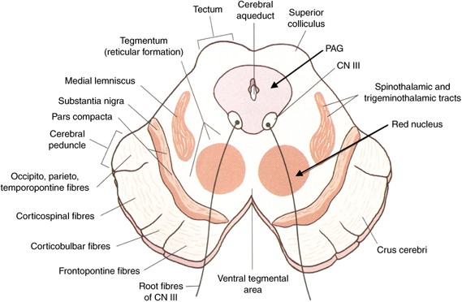
Substantia nigra
The substantia nigra is a semilunar
lamina of heavily pigmented neurons
located between the crus cerebri and
the mesencephalic tegmentum.
It has 2 parts:
Dorsal pars compacta: composed of neurons that produce the neurotransmitter dopamine. It connects the striatum via the nigeostriatal pathway and facilitates its activity.
Ventral pars reticulata: composed of the neurons that mainly produce inhibitory neurotransmitter GABA. This part of substantia nigra receives the information from the stratum, after which it further projects to the thalamus.

Slide 14
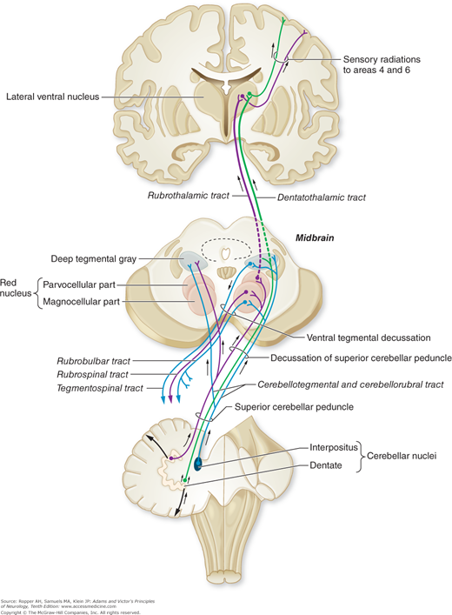
The red nucleus
The red nucleus (nucleus rubber)
is an ovoid mass located
dorsomedial to substantia nigra at
the level of superior colliculus. It
bears this mass due to its reddish
color that this nucleus has on
fresh specimen, due to its high
iron content.
It consists of 2 parts:
The caudal (magnocellular) portion
The rostral (parvocellular) portion

Slide 15
The ascending pathways
The ascending bundle consists
of the cerebellothalamic tract
and cerebellorubral tracts.
The cerebellothalamic tract continues its pathway through the brainstem to reach the ventrolateral nucleus of the thalamus.
The cerebellorubral tract synapses with the contralateral red nucleus.
A small amount of the ascending fibers synapses with the periaqueductal gray and reticular formation.

Slide 16
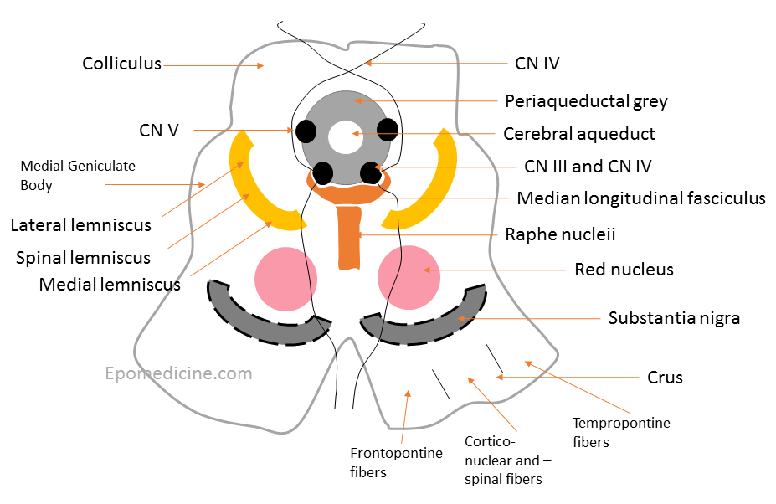
The descending pathways
This consists of the fibers that
synapse with the reticular formation
of the pons, medulla as well as with
the Olivary nuclei.
It consists of 5 sensory pathways:
Medial longitudinal fasciculus: located at the dorsal decussation of the superior cerebellar peduncle.
Medial lemniscus: is a sensory pathway that continues on the dorsal column of the spinal cord, forming the dorsal column-medial lemniscus pathway.
Trigeminal lemniscus: it carries tactle, pain and temperature sensations from head to the thalamus.

Slide 17
4. Spinal lemniscus: conveys pain, temperature, non- discriminative touch and pressure information to the thalamus.
5. Lateral lemniscus: It passes the auditory information from the cochlear nucleus to the contralateral inferior colliculus.

Slide 18
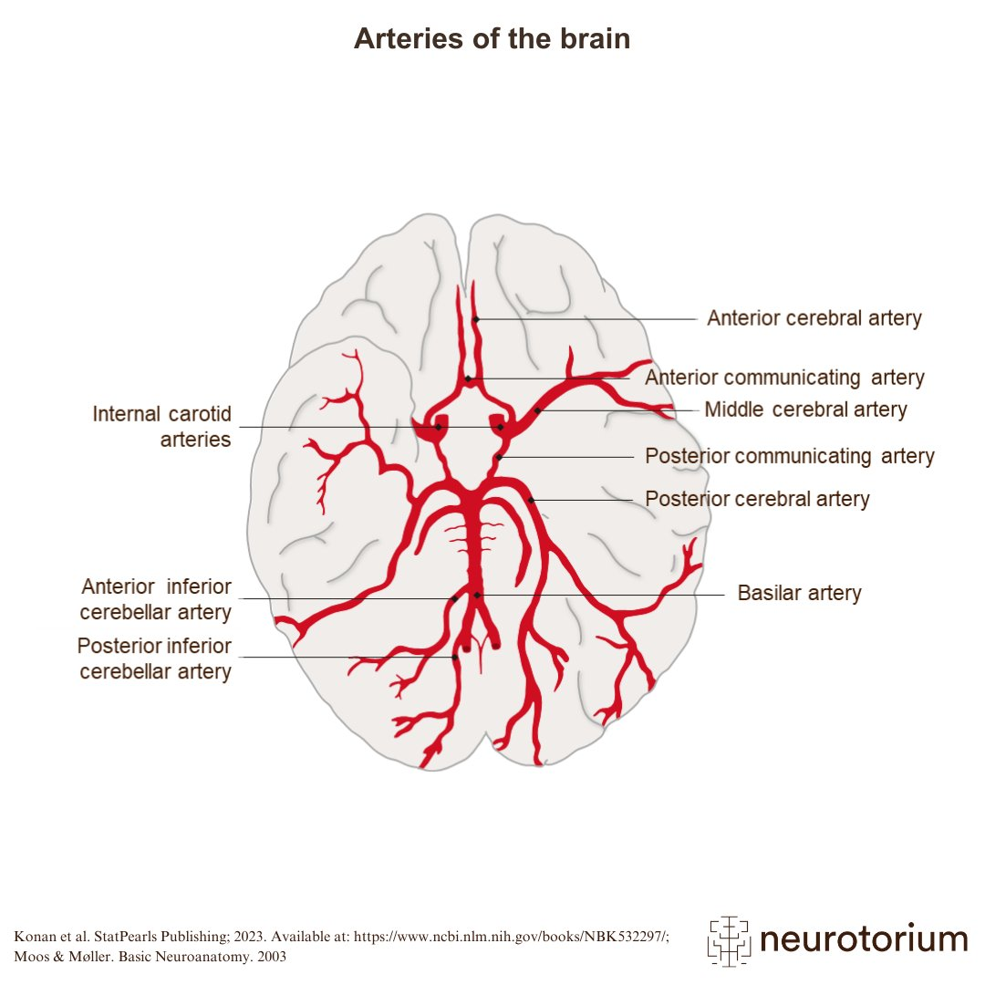
Blood supply
The tectum of the midbrain receives its blood
supply from the superior cerebellar artery.
The central part of the tegmentum is supplied by the posterior cerebral artery and paramedian branches of the basilar artery.
Most lateral parts of the midbrain are nourished by the posterior cerebral artery solely.

Slide 19
Functions of the midbrain
It provides passage for the main descending pathways of the cerebral cortex
It acts as a conduit for the main ascending pathways from the spinal cord which carry the sensory stimuli from the body and head to the brain
It houses the mesencephalic portion of the reticular formation which controls pain and mood
Connecting with the auditory and visual nuclei, it enables the auditory and ocular reflexive movements.

Slide 20
Clinical significance
Parinaud’s syndrome: damage to the tectum of the midbrain may cause inability to gaze upwards and downwards as the corpora quadrigemina will be affected.
Weber’s syndrome: an aneurysm in the posterior cerebral artery at the circle of willis can cause weakness in the tongue, palate and lower face.

Slide 21

Thanks for listening

